Slide 1
Newspapers
Readership:
  53 million U.S. households during week and nearly 55 million on Sundays.
  Historically leading medium but in constant decline
Buying Newspaper Space
  Standardized Advertising Unit (SAU) system
    1 column: 2¹/16 inches 2 columns: 4¹/4 inches
    3 columns: 6⁷/16 inches 4 columns: 8⁵/8 inches
    5 columns: 10¹³/16 inches 6 columns: 13 inches
    Space depth: 1 inch to 21 inches
    Space rates apply to ROP (run of press)
    Premium rates for preferred space positioning
© 2010 South-Western, a part of Cengage Learning. All rights reserved.
12–<number>

Slide 2


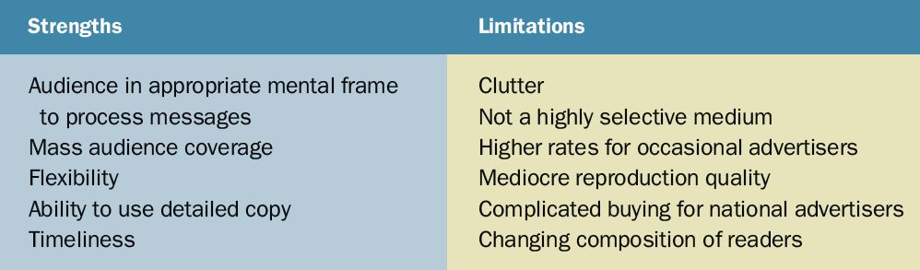
Table 12.1
Newspaper Advertising’s Strengths and Limitations
© 2010 South-Western, a part of Cengage Learning. All rights reserved.
12–<number>

Slide 3
Magazines
Special Interest Magazines
  Consumer-oriented
  Business-oriented
Standard Rate and Data Service (SRDS Media Solutions)
  Tracks information on standardized ad rates, contact information, reader profiles, and other information, which facilitates media planning and buying.
© 2010 South-Western, a part of Cengage Learning. All rights reserved.
12–<number>

Slide 4

Magazines (cont’d)
Buying Magazine Space
  Selecting magazines that reach the target market
  Sources for cost
  considerations
    Media Kits
      Demographic composition
      of magazine’s readership
      Rate cards
    CPM (Cost-per-thousand)
    Information
      Mediamark Research, Inc. (MRI)
      Simmons Market Research Bureau (SMRB)
© 2010 South-Western, a part of Cengage Learning. All rights reserved.
12–<number>

Slide 5
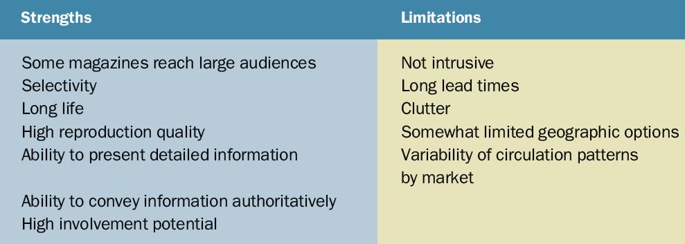
Table 12.2
Magazine Advertising’s Strengths and Limitations
© 2010 South-Western, a part of Cengage Learning. All rights reserved.
12–<number>

Slide 6
Magazines (cont’d)
Selecting the Magazine
  The size of the potential audience that a vehicle might reach
  The attractiveness of its coverage as revealed by the total product purchasers exposed to that vehicle and compared with other media
  Its cost compared with other vehicles
  Its appropriateness for the advertised brand
© 2010 South-Western, a part of Cengage Learning. All rights reserved.
12–<number>

Slide 7
Radio
Market Coverage
  Nearly 14,000 commercial radio stations in the United States
  Almost 100 percent of all homes have radios; most
  homes have several
  Virtually all cars have a radio
  More than 50 million radios are purchased in the United States each year
  Radio broadcasting in the United States reaches about 93 percent of all people age 12 or older.
© 2010 South-Western, a part of Cengage Learning. All rights reserved.
12–<number>

Slide 8
Radio (cont’d)
Factors in Buying Radio Time
  Matching station format with target market
  Choosing a station with geographic coverage in areas of dominant influence (ADIs)
  Day part choice
    Morning drive: 5 AM to 10 AM
    Midday: 10 AM to 3 PM
    Afternoon drive: 3 PM to 7 PM
    Evening: 7 PM to Midnight
    Late night: Midnight to 7 AM
© 2010 South-Western, a part of Cengage Learning. All rights reserved.
12–<number>

Slide 9
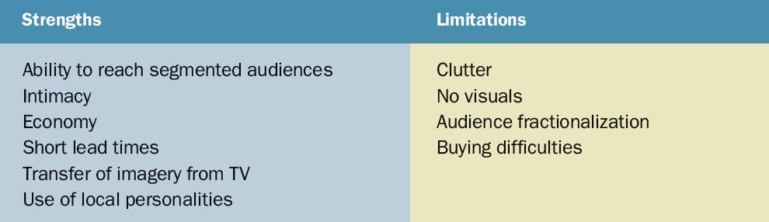
Table 12.4
Radio Advertising’s Strengths and Limitations
© 2010 South-Western, a part of Cengage Learning. All rights reserved.
12–<number>

Slide 10
Television
Television
  Is in over 98% of all households have televisions
  Is a uniquely personal and demonstrative medium
  Is expensive to produce and broadcast
Television Programming Dayparts
  Early morning: 5 AM to 9 AM
  Daytime: 9 AM to 4 PM
  Early fringe: 4 PM to 7 PM
  Prime access: 7 PM to 8 PM
  Prime time: 8 PM to 11 PM
  Late fringe: 11 PM to 2 AM
  Overnight: 2 AM to 5 AM
© 2010 South-Western, a part of Cengage Learning. All rights reserved.
12–<number>

Slide 11
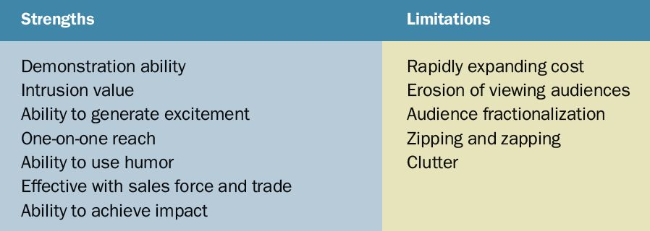
Table 12.7
Television Advertising’s Strengths and Limitations
© 2010 South-Western, a part of Cengage Learning. All rights reserved.
12–<number>

